Slide 1
Information Security Fall 2022
Week # 3
Lecture # 7, 8 and 9
Dr. Aqsa Aslam

Slide 2
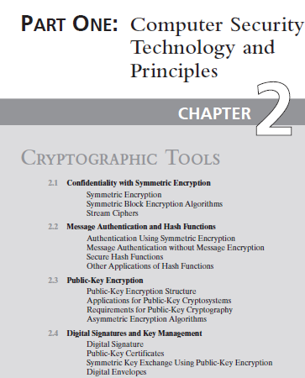
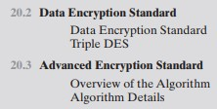

Topics from text book:
Chapter # 2
Chapter # 20
Chapter # 21

Slide 3
ADVANCED ENCRYPTION STANDARD
The Advanced Encryption Standard (AES) was issued as a federal information processing standard FIPS 197 (Advanced Encryption Standard, November 2001).
It is intended to replace DES and triple DES with an algorithm that is more secure and efficient.
AES is a non-Feistel cipher that encrypts and decrypts a data block of 128 bits.
AES has defined three versions, with 10, 12, and 14 rounds.
Each version uses a different cipher key size (128, 192, or 256).

Slide 4
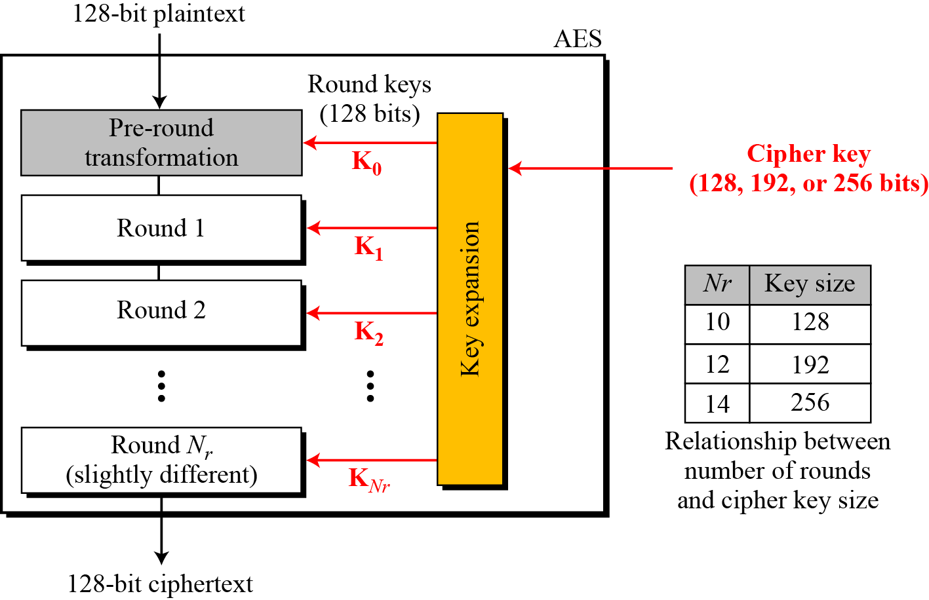
Figure 7.1 General design of AES encryption cipher
Fixed size=128 bit i-e., 16bytes
→ No: of key generated =no: of round+1(extra for pre-round transformation)

Slide 5
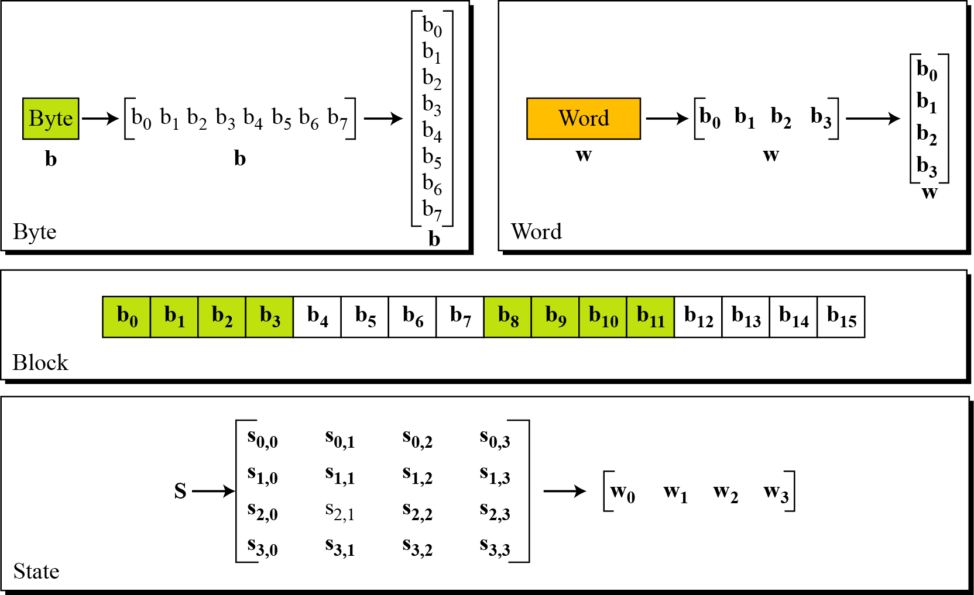
7.1.4 Data Units.
1 byte= group of 8 bit
1 word=4 bytes=32 bit
Block size=128 bit data
Figure 7.2 Data units used in AES
4 word
4×4=16 bytes i-e
128 bits or 4 words
1 byte
S_{0,0 =}1st byte of 0th word
1 word
State: it told intermediate result

Slide 6
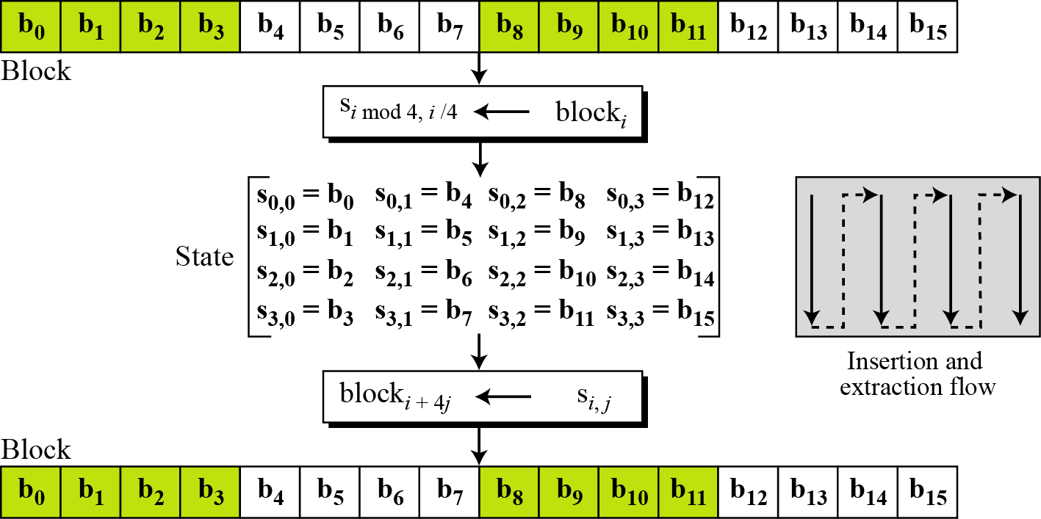
7.1.4 Data Units.
Figure 7.3 Block-to-state and state-to-block transformation

Slide 7
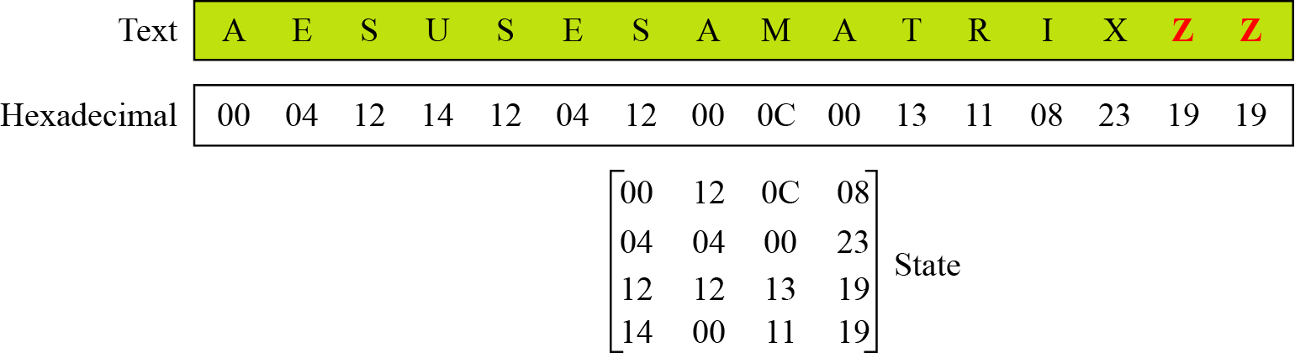
7.1.4 Continue
Example 7.1
Continue
Figure 7.4 Changing plaintext to state

Slide 8
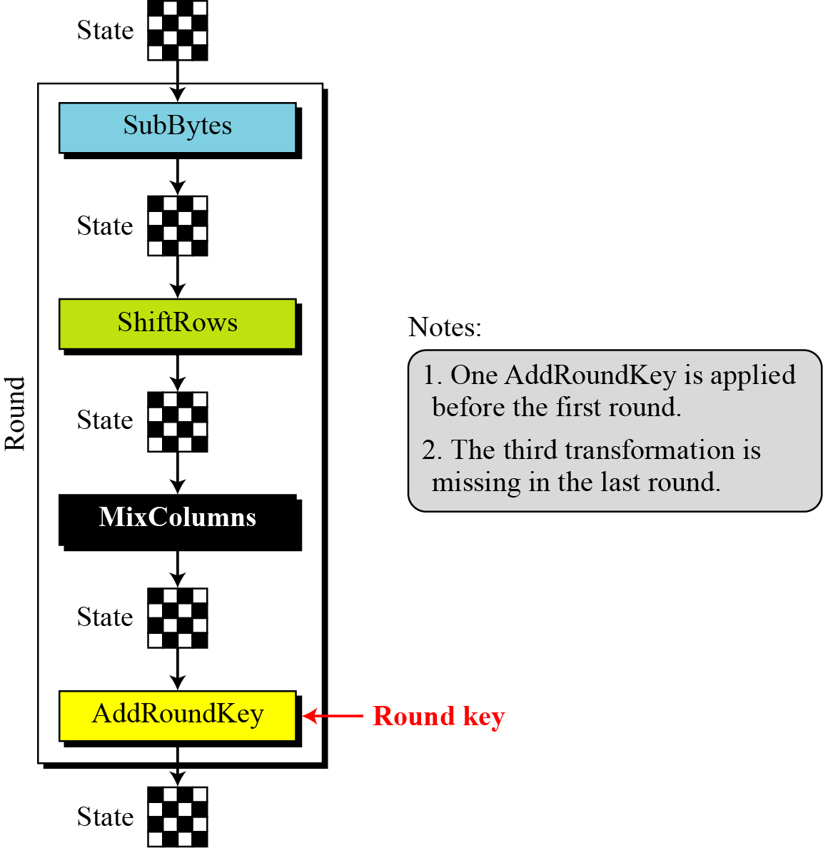
7.1.5 Structure of Each Round
Figure 7.5 Structure of each round at the encryption site

Slide 9
AES - Steps
KeyExpansion—round keys are derived from the cipher key using Rijndael's key schedule.
Initial Round
AddRoundKey—each byte of the state is combined with the round key using bitwise xor.
Round
Four different stages are used, one of permutation and three of substitution:
Substitute Bytes: Uses a table, referred to as an S-box,3 to perform a byteby-byte substitution of the block
Shift Rows: A simple permutation that is performed row by row
Mix Columns: A substitution that alters each byte in a column as a function of all of the bytes in the column
Add Round key: A simple bitwise XOR of the current block with a portion of the expanded key
Final Round (no Mix-Columns)
SubBytes
ShiftRows
AddRoundKey

Slide 10
TRANSFORMATIONS
Four different stages are used, one of permutation and three of substitution:
Substitute Bytes: Uses a table, referred to as an S-box,3 to perform a byteby-byte substitution of the block
Shift Rows: A simple permutation that is performed row by row
Mix Columns: A substitution that alters each byte in a column as a function of all of the bytes in the column
Add Round key: A simple bitwise XOR of the current block with a portion of the expanded key

Slide 11

7.2.1 Substitution
AES, like DES, uses substitution. AES uses two invertible transformations.
SubBytes
The first transformation, SubBytes, is used at the encryption site. To substitute a byte, we interpret the byte as two hexadecimal digits.
Note
The SubBytes operation involves 16 independent byte-to-byte transformations.

Slide 12
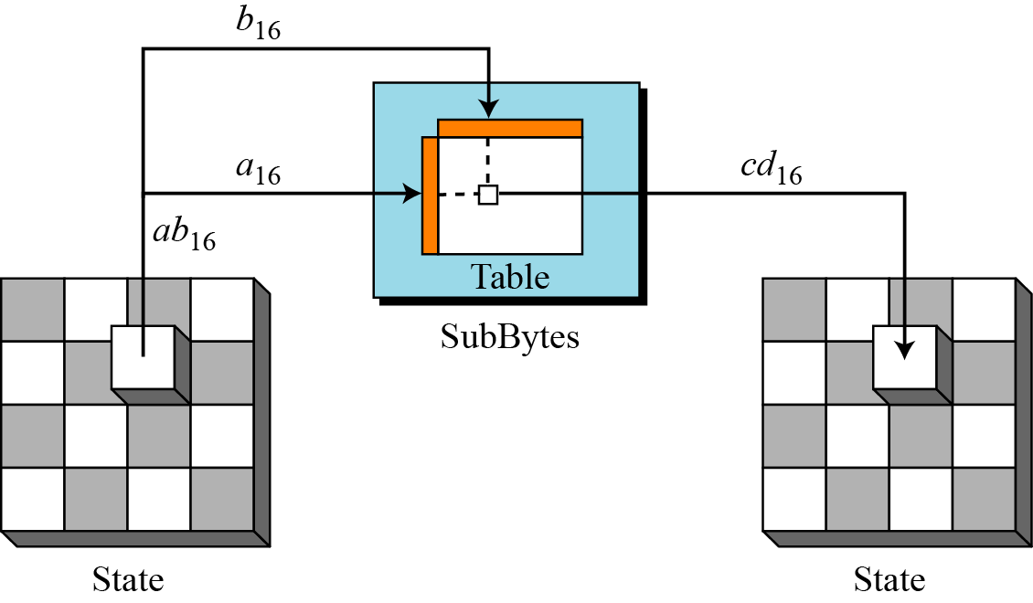
7.2.1 Continue
SubBytes is simply a table lookup using a 16×16 matrix of byte values called an s-box. This matrix consists of all the possible combinations of an 8 bit sequence (28= 16×16 = 256).
Figure 7.6 SubBytes transformation
Substitution Table
16×16= S-box

Slide 13
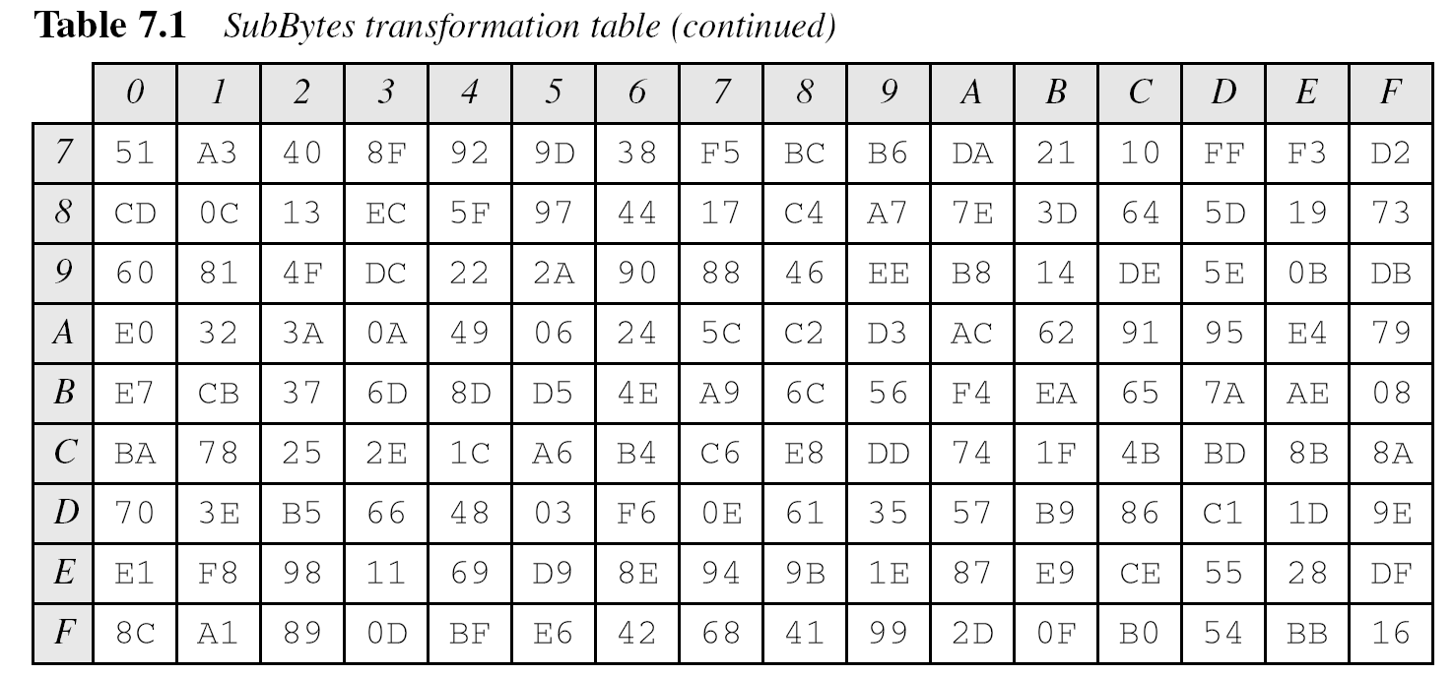
16×16= S-box
16×16= S-box
16 bytes
Initial byte represent rows and last part represent column e.g 000 0010. (0 row and 2 column)

Slide 14
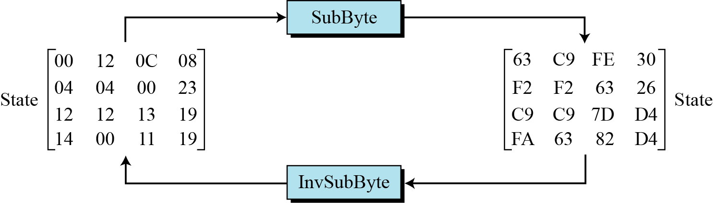

Slide 15
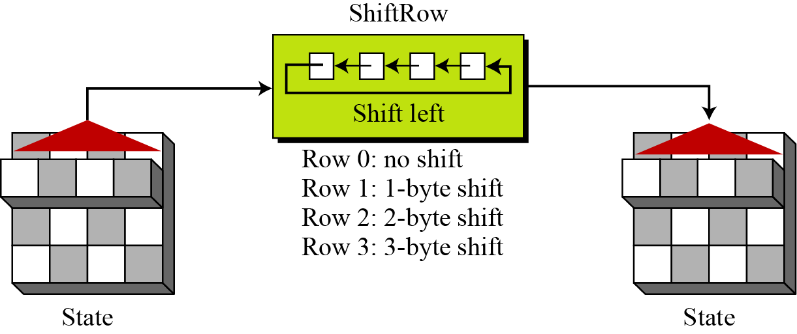
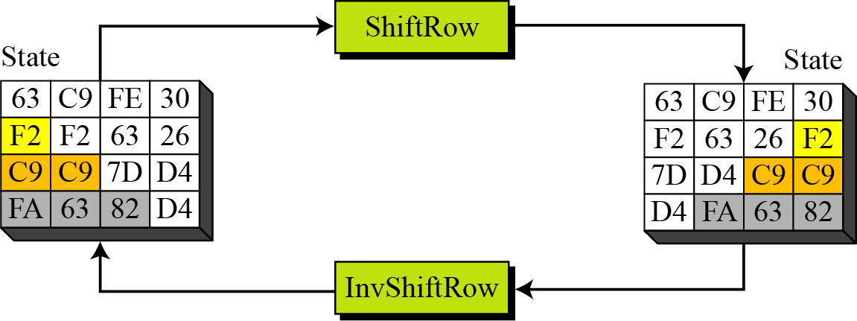
7.2.2 Permutation
Another transformation found in a round is shifting, which permutes the bytes
In the encryption, the transformation is called ShiftRows
Permutation perform on a byte level
Shift is done to the left
Shift depends on the
row of the matrix
Figure 7.9 ShiftRows transformation

Slide 16
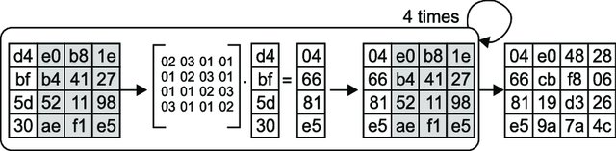
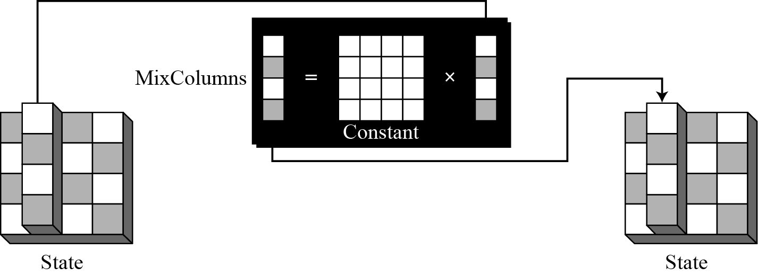
MixColumns
The MixColumns transformation operates at the column level; it transforms each column of the state to a new column.
Example
Figure 7.13 MixColumns transformation

Slide 17
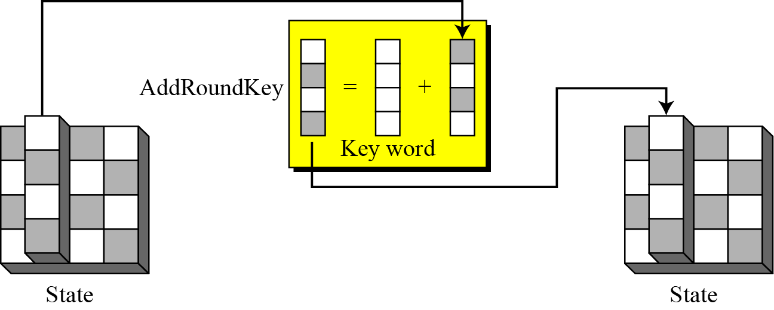
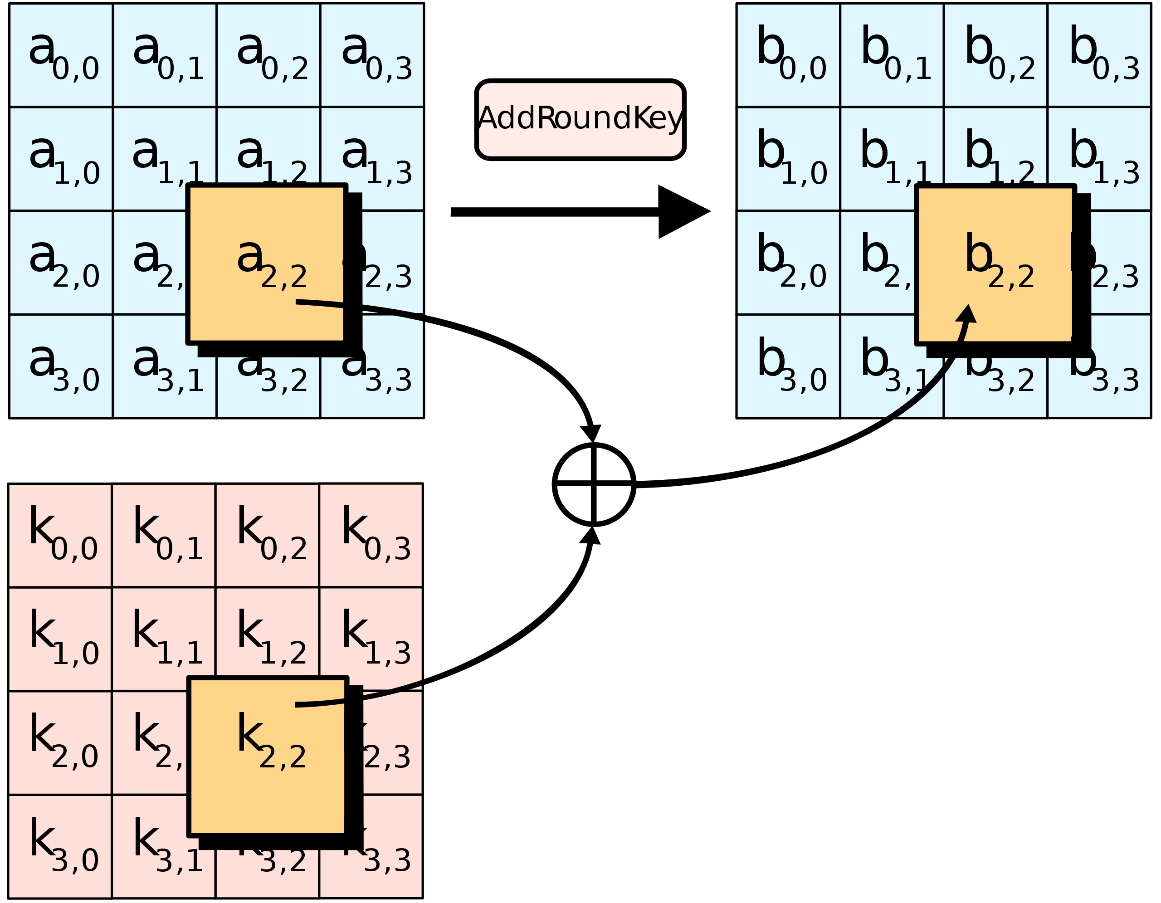
AddRoundKey
In the forward add round key transformation, called AddRoundKey, the 128 bits of State are bitwise XORed with the 128 bits of the round key.
Figure 7.15 AddRoundKey transformation

Slide 18
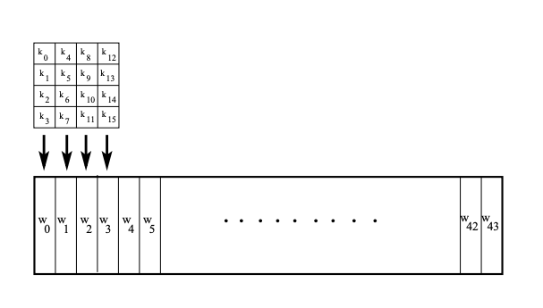
AES Key Expansion
To create round keys for each round, AES uses a key-expansion process. The AES key expansion algorithm takes as input a 4-word (16-byte) key and produces a linear array of 44 words. This is sufficient to provide a 4-word round key for the initial Add Round Key stage and each of the 10 rounds of the cipher.
input a 4-word (16-byte) key
linear array of 44 words

Slide 19
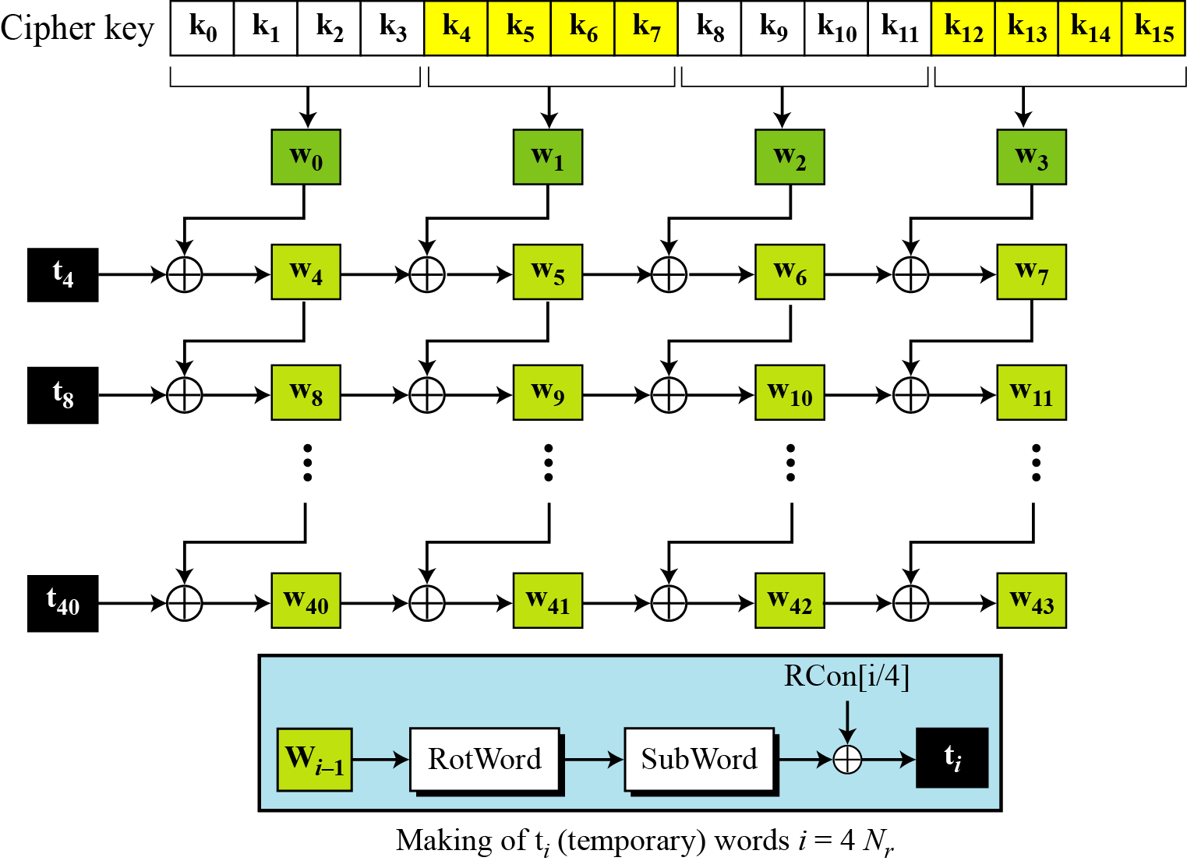
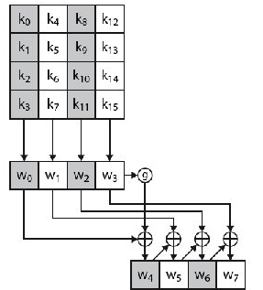
AES Key Expansion
To create round keys for each round, AES uses a key-expansion process. The AES key expansion algorithm takes as input a 4-word (16-byte) key and produces a linear array of 44 words. This is sufficient to provide a 4-word round key for the initial Add Round Key stage and each of the 10 rounds of the cipher.
Figure 7.16 Key expansion in AES

Slide 20
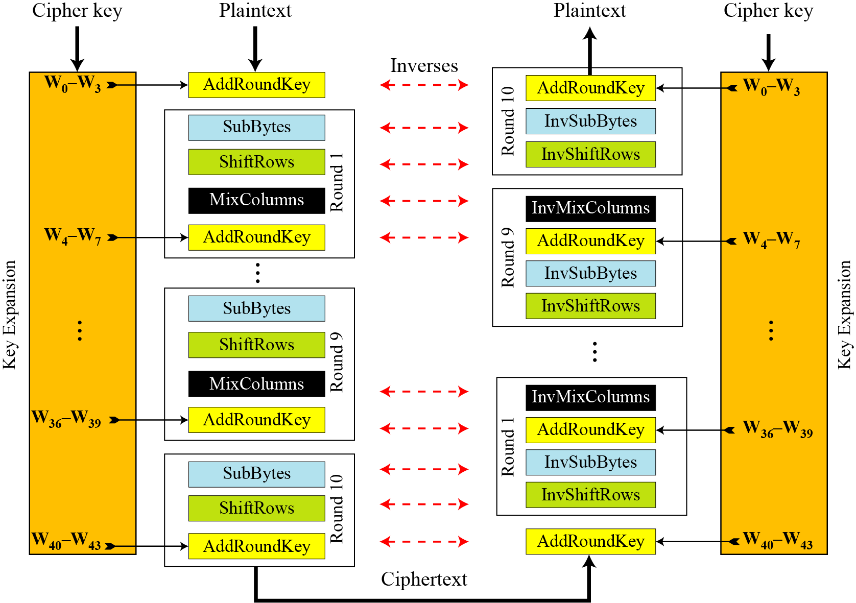
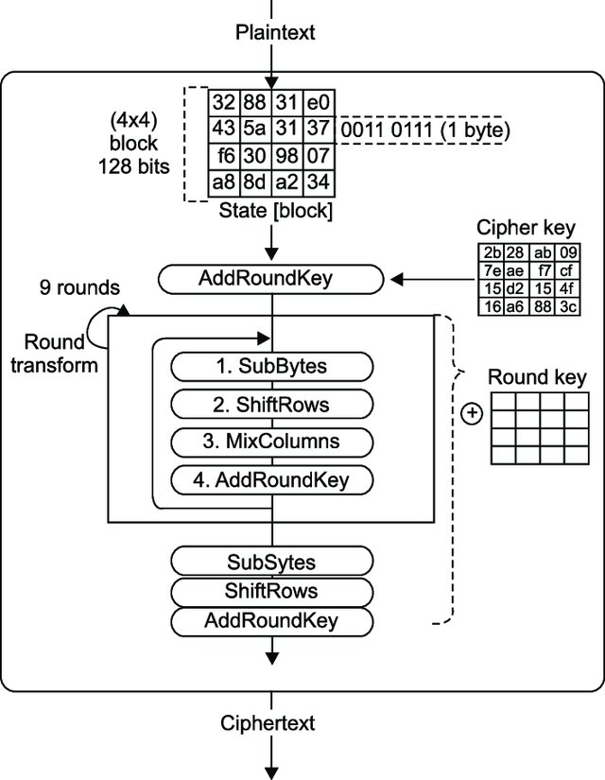
Ciphers and inverse ciphers of the original design

Slide 21
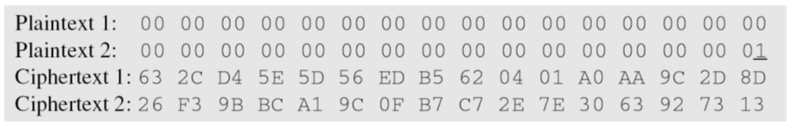
Claude Shannon (1949) gave two properties that a good cryptosystem should have to hinder statistical analysis: diffusion and confusion.
Diffusion means that if we change a character of the plaintext, then several characters of the ciphertext should change, and similarly, if we change a character of the ciphertext, then several characters of the plaintext should change.
Confusion means that the key does not relate in a simple way to the ciphertext. In particular, each character of the ciphertext should depend on several parts of the key.
Confusion = Substitution a --> b, Diffusion = Transposition or Permutation abcd --> dacb

Slide 22
